Slide 1
Cancer
Lesson 3.4
How does DNA damage allow cancer cells to cheat death?
The Picture of Dorian Gray

Slide 2
Do Now
What happens to our DNA as we age?
What happens to our cells as our DNA ages?

Slide 3
What happens when we age?
Cells replicate for a limited amount of time then die
Stem cells replace dead cells
What happens to stem cells as we age?

Slide 4
Stem cells are like “Babies”
Stem cells grow old too!
Stem cell pool gets depleted
Replace stem cells
Replicate to produce daughter stem cells

A stem cell
can……..

Specialize or differentiate into many cell types
Replace dying cells
Damaged tissue in aging body is not replaced

Slide 5
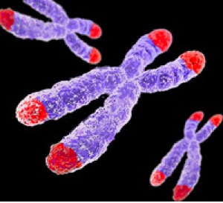
How do cells know when to die?
Telomeres
Telomeres
Telomeres are repetitive DNA at the end of chromosomes.
Telomere DNA doesn’t code for genes.
The cell doesn’t replicate the ends of its chromosomes very well.
Notes:
Modified the text

Slide 6
What happens to DNA as a cell replicates?
The end replication problem
What will happen to the telomere at the end of the chromosome every time the cell divides?

Slide 7
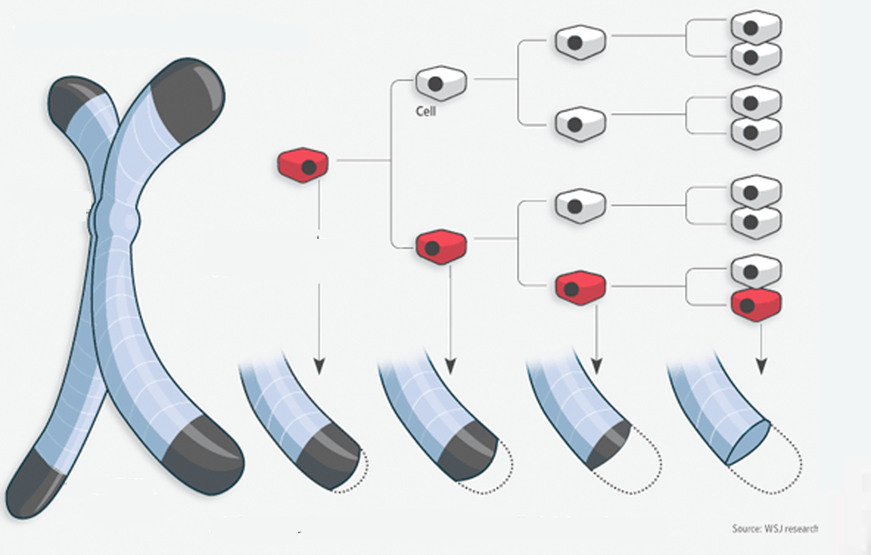
How do telomeres work?
Chromosome
Each time
the cell divides
The telomeres get shorter
Telomere

Slide 8
When cells reach old age they stop proliferating
Critically short telomeres
p53 activated
Proliferation stops
(Senescence)

Slide 9
What happens when telomeres shorten?
Telomere DNA
Chromosome DNA
Telomere DNA
Cells
replicate
Senescence

Slide 10
What happens when p53 is mutated?
Critically short telomeres

p53 activated
CRISIS!!
Chromosomes fuse
Apoptosis

Slide 11
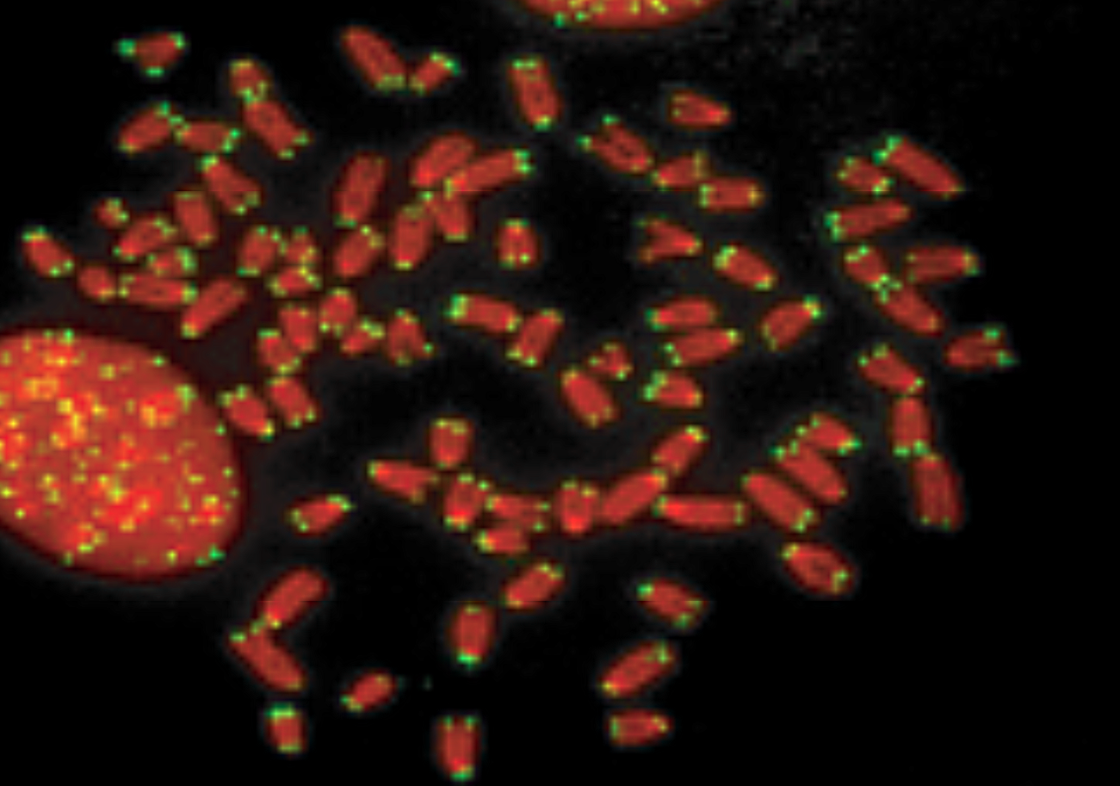
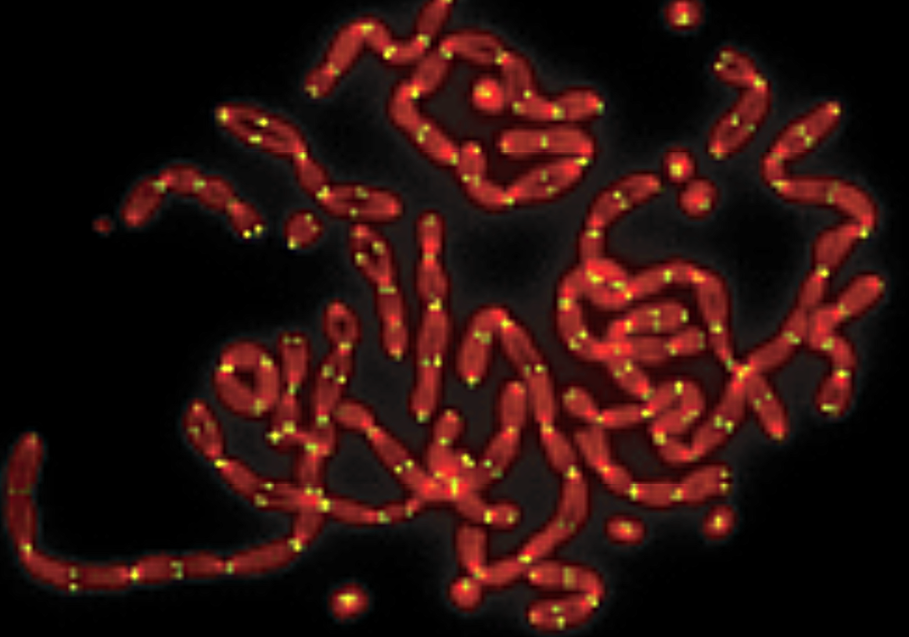
What happens in Crisis?
Normal cell
Cell in crisis
Why would cells undergo crisis?
How could a cell avoid crisis?

Slide 12
Telomerase makes cells Immortal!
What would happen to cancer cells that express telomerase?

Slide 13
Cancer cells turn telomerase ON
What would happen if cancer cells did not turn on telomerase?
How do cancer cells turn telomerase ON?

Slide 14
Activity
Can inhibitors of telomerase be used as drugs to treat cancer?

Slide 15
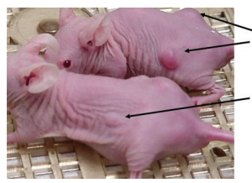
Results of the experiment
Treated:
Tumor size 147mm²
Untreated:
Tumor size 24mm²

Slide 16
Wrap up
How did you interpret the results from the second experiment?
90% of tumors express telomerase – how do you incorporate this information into your interpretation?
How might you be able to solve the problem these results revealed?

Slide 17
Wrap up
How many of you still think that inhibiting telomerase can be used to treat cancer?

Slide 18
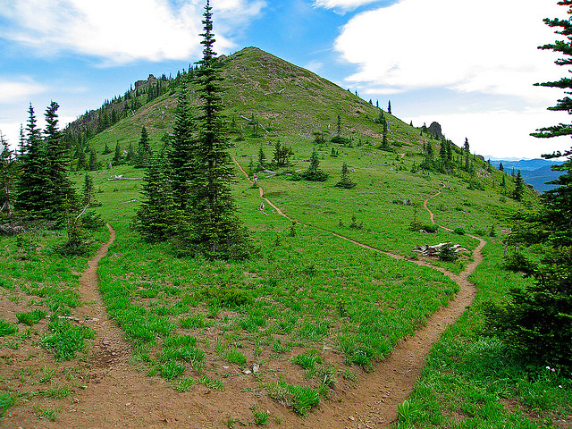
Many paths to the top of the mountain!
10%-15% of tumors don’t have telomerase activity.
The alternative lengthening of telomeres (ALT) pathway is active in the 10% of tumors that don’t have telomerase activity
Mutations that overcome normal cell regulation will allow tumors to persist and grow.

Slide 19
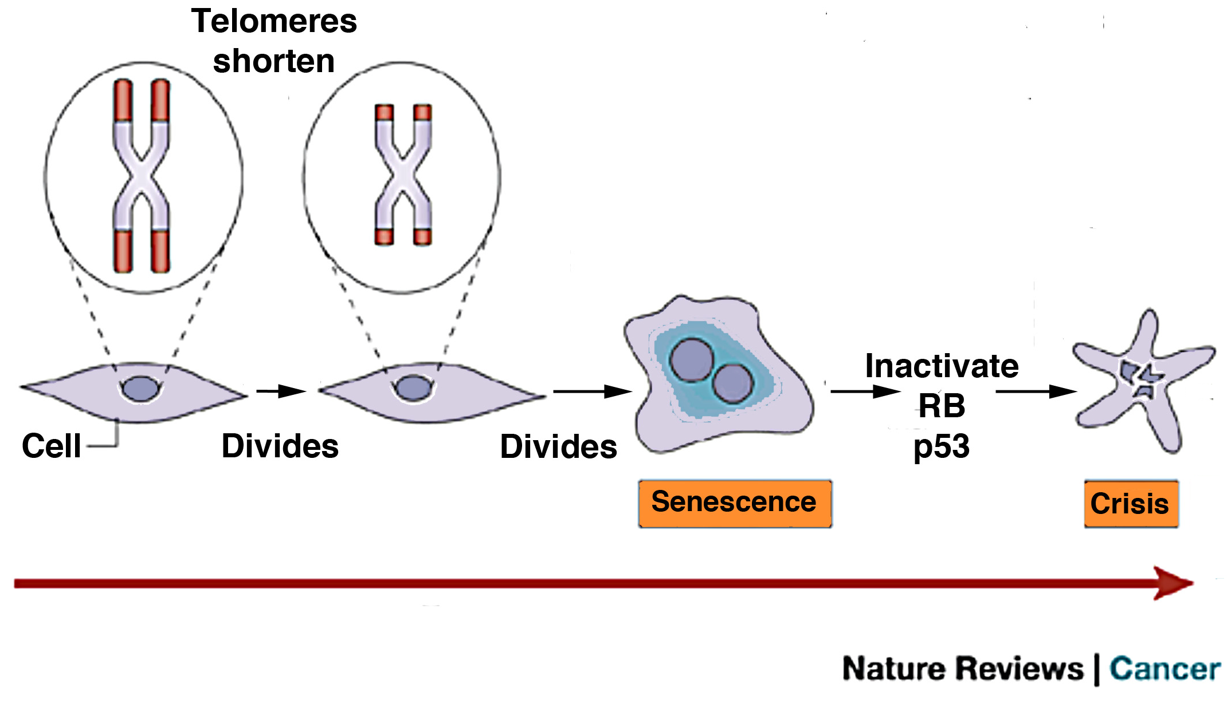
Wrap Up: Telomeres in normal cells
p53
Inactivated p53
Notes:
Modified for clarity

Slide 20
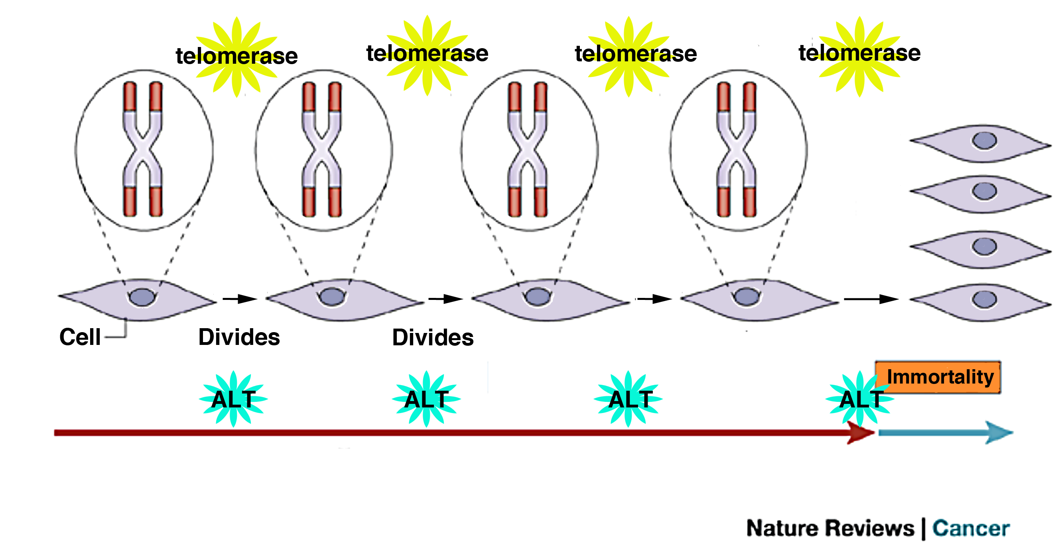
Wrap Up: Telomeres in cancer

Slide 21
Homework
Read the article about woman who lived to be 115 and how her blood holds the secret of immortality

